Slide 1
FACE RECOGNITION USING DEEP LEARNING

Slide 2
INTRODUCTION
-Recognizing and manipulating faces from Python or from the command line with the world's simplest face recognition library
-Can be used to find missing person -Improvement of medical treatment

Slide 3
Methodology
-The tools of approach:
*python3.10.0, pycharm(dlib, cmake, openface, opencv-python, face recognition, numpy)
Algorithms: -HOG, Linear SVM

Slide 4
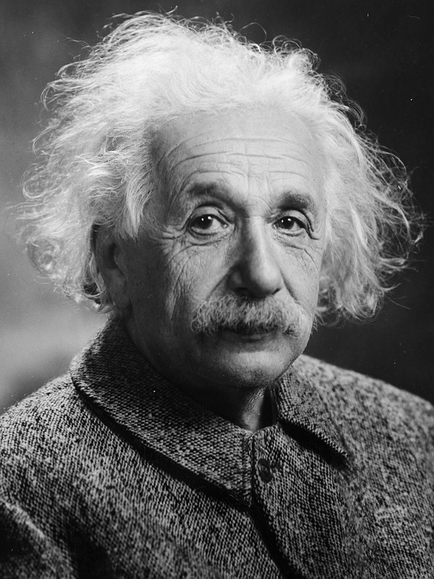
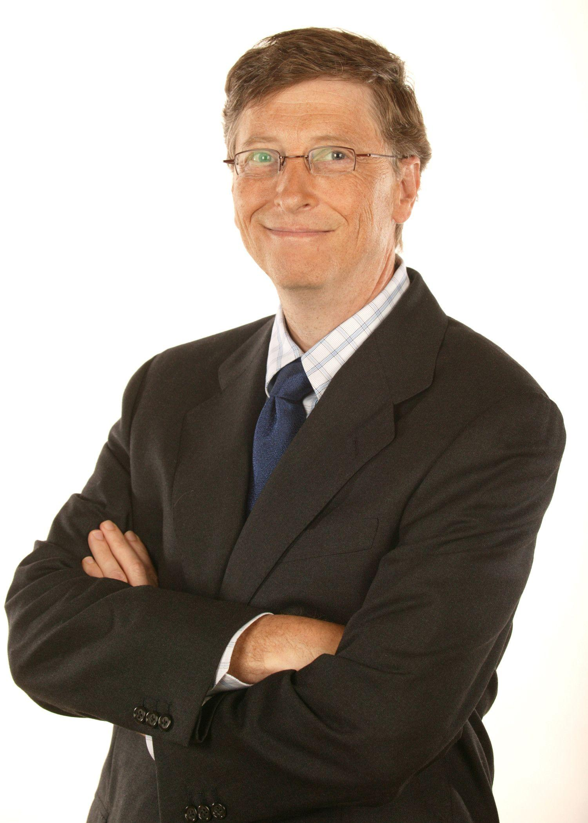
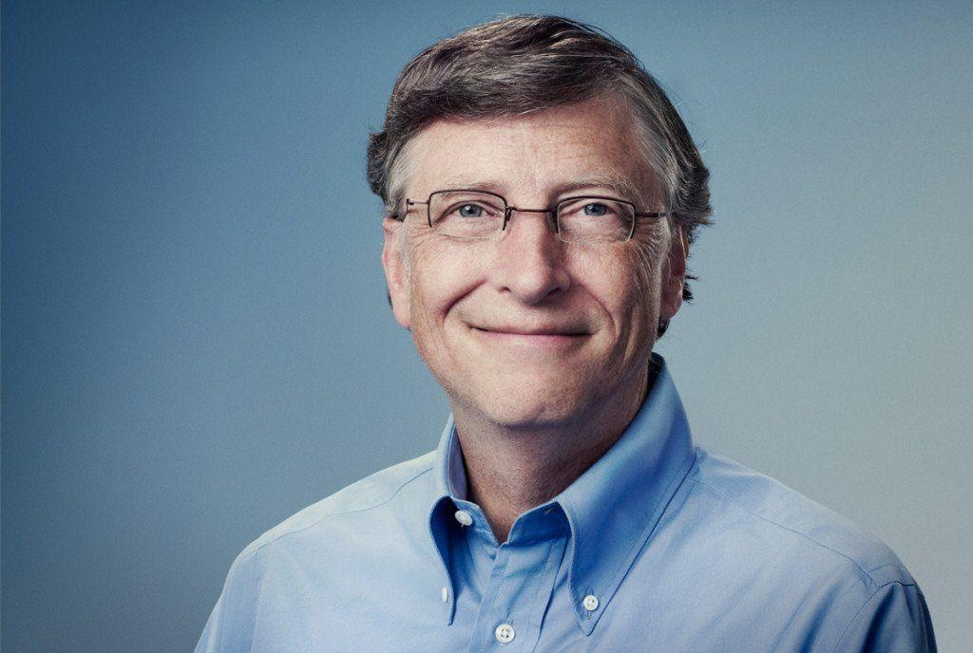
Methodology
Dataset:

Slide 5
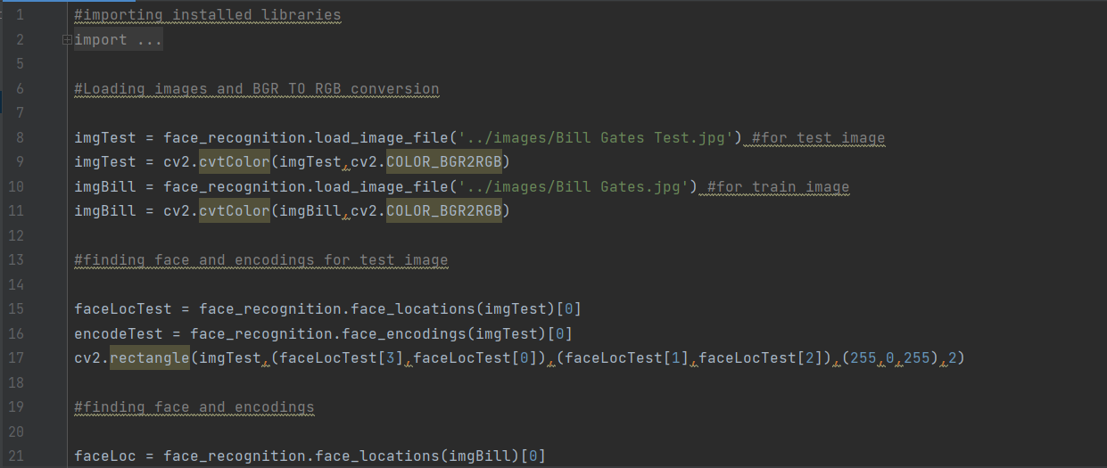
Methodology
Step:1

Slide 6
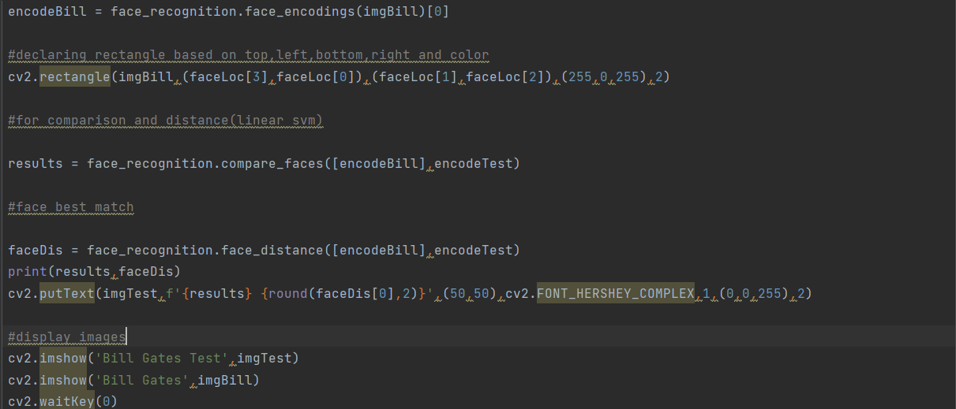
Methodology
Step:2

Slide 7
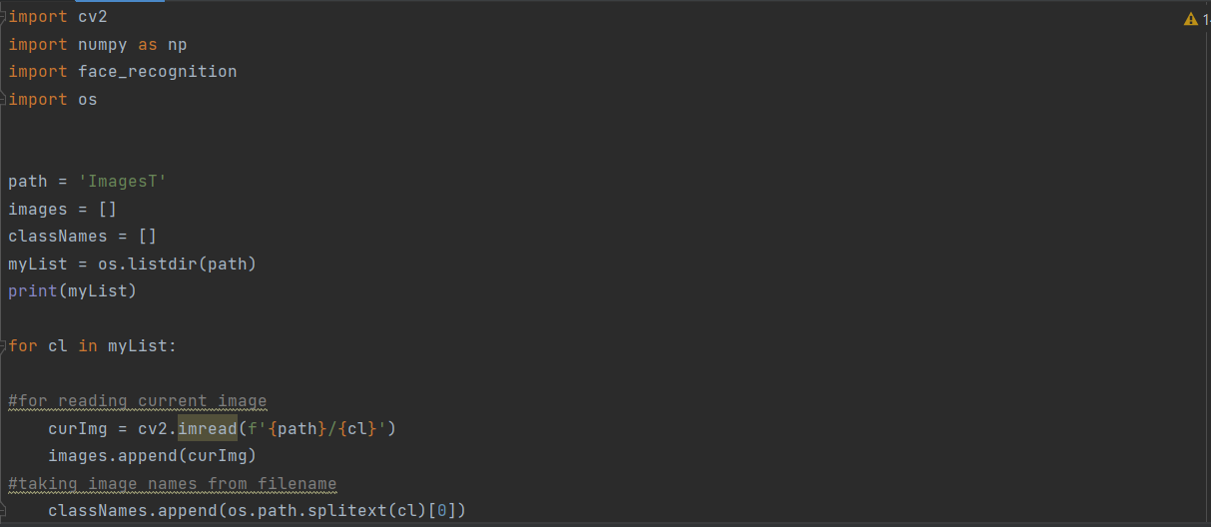
Methodology
Step:3

Slide 8
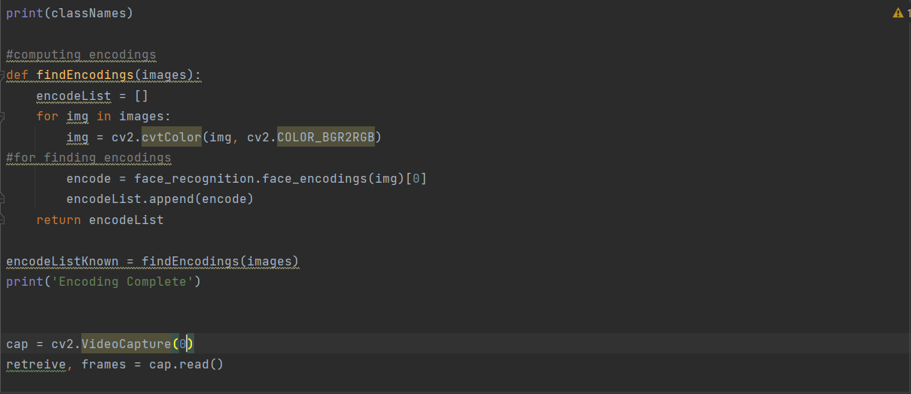
Methodology
Step:4

Slide 9
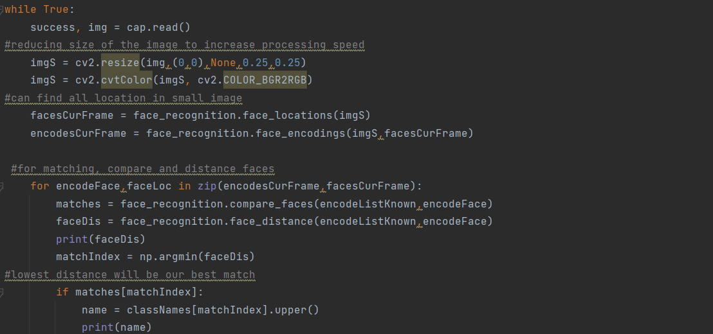
Methodology
Step:5

Slide 10
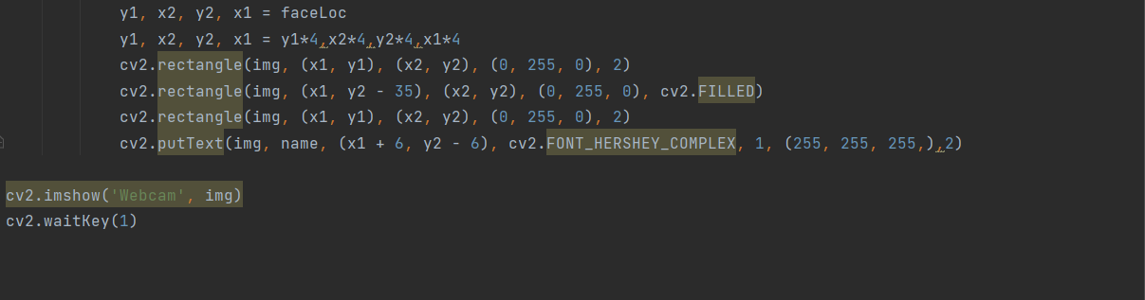
Methodology
Step:6

Slide 11
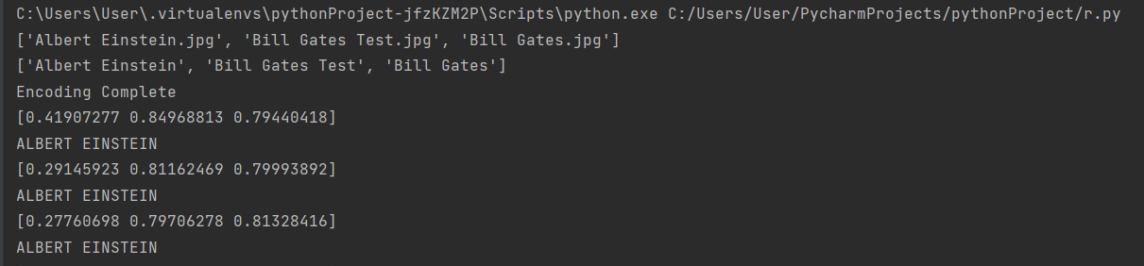
Result
-After giving the input image

Slide 12
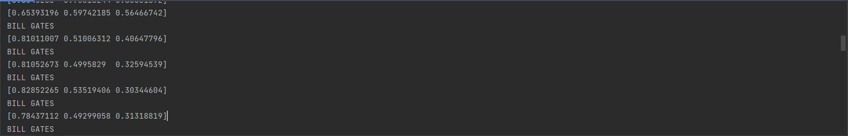
Result
-After giving the input image

Slide 13
Summary
-Selected appropriate algorithms for the system -Loaded images and resize them to boost up the process
-Conversion of BGR to RGB -Encoding the images
-Matching, compare and distance logics
-Providing input and observing the output measurement

